Slide 1

Cross-Domain Hyperspectral Image Classification via Mamba–CNN and Knowledge Distillation
Aoyan Du¹, Guixin Zhao¹, Yuyao Wang²,
Aimei Dong¹, Xiangjun Dong¹
¹Shandong Computer Science Center
²Department of Mathematics and Statistics, Boston University
IEEE TRGS 2025

Slide 2
Outline
Introduction
- Background
- Motivation
Method
Experiments
Conclusion

Slide 3
Background
Remote sensing data: HSI, LiDAR, SAR
HSI → fine-grained spectral info, accurate land cover classification
Problem: scene-specific methods, poor generalization
Need: apply model from Source Domain (SD) → Target Domain (TD)

Slide 4
Motivation → Our Solution
1. Feature Extraction Challenge
Problem:
CNN → good at local details, weak at long-range.
Transformer → good at global context, but costly & miss fine details.
Mamba → efficient for long-range, weak for local.
Our Solution:
Hybrid Network (MKDnet) = Mamba + CNN
→ joint global + local feature extraction
→ capture long-range dependencies + fine details in HSI.

Slide 5
Motivation → Our Solution
2. Inter-Class Feature Consistency
Problem:
Most DA methods align marginal distributions only.
→ Ignore class-level relationships, leading to confusion between classes.
Our Solution:
Knowledge Distillation (STKD) with soft labels
→ preserve inter-class similarities & differences
→ stronger alignment, less class confusion.

Slide 6
Motivation → Our Solution
3. Robust Domain Alignment
Problem:
Traditional alignment ignores graph topology.
Large SD–TD discrepancy → risk of negative transfer.
Our Solution:
Graph Alignment with GCN + Consistency Constraints
→ dynamically model spectral–spatial topology
→ enforce consistency in distribution + graph alignment
→ robust against domain shift.

Slide 7
Outline
Introduction
Method
Experiments
Conclusion

Slide 8
Overview
Mamba
New State Space Model (SSM) → combines control theory + DL
Strength: captures long-range dependencies efficiently
Gap: underexplored for high-dim HSI → potential for global feature modeling
Knowledge Distillation (KD)
Student learns from teacher → hard + soft labels
Soft labels: encode inter-class similarity, improve generalization
Gap: limited use in cross-domain HSI → can enhance inter-class consistency
Graph Neural Networks (GNNs)
Key idea: aggregate neighbor info recursively, designed for graph-structured data
GraphSAGE: iterative neighbor sampling + aggregation
Relevance: model spectral–spatial topology in HSI, support alignment

Slide 9
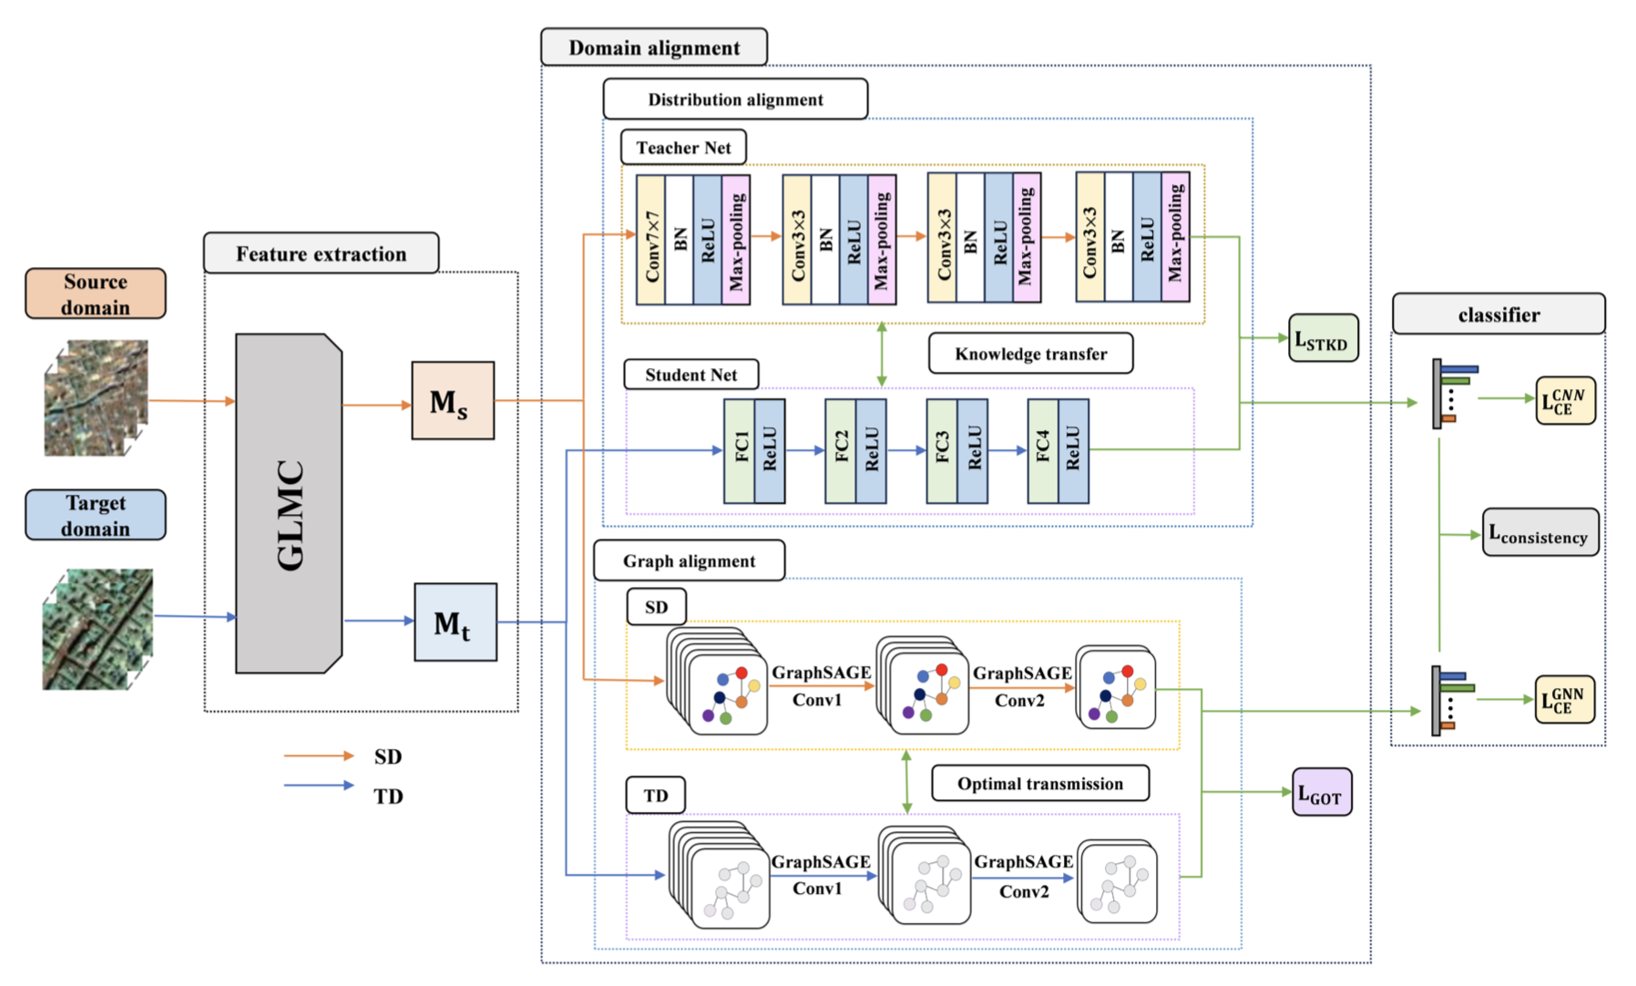
Method:
The proposed MKDnet consists of three key modules:
Feature extractor – jointly captures global and local HSI features.
Domain alignment – includes distribution alignment (via knowledge distillation) and graph alignment (via GOT).
Classifier – ensures domain-invariant prediction.
Pipeline:
Input labeled patches from SD + unlabeled patches from TD
Extract features → align (distribution + graph) → classify TD

Slide 10
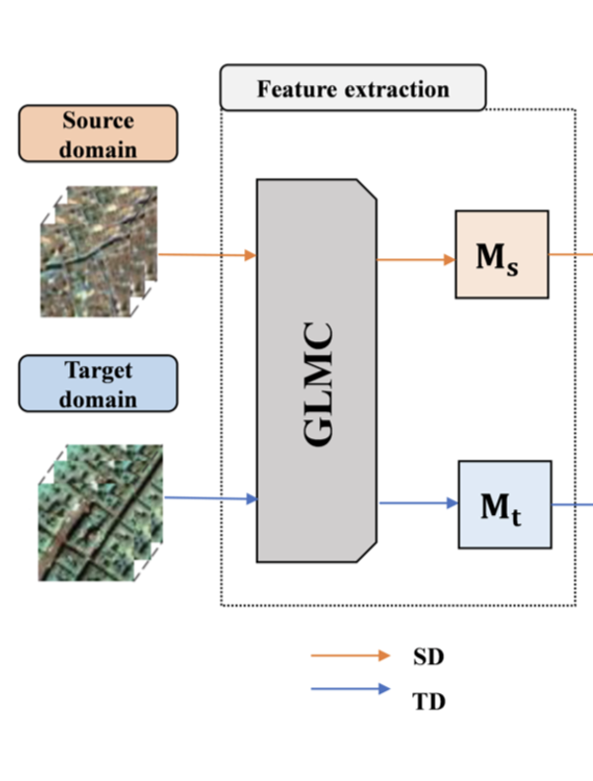
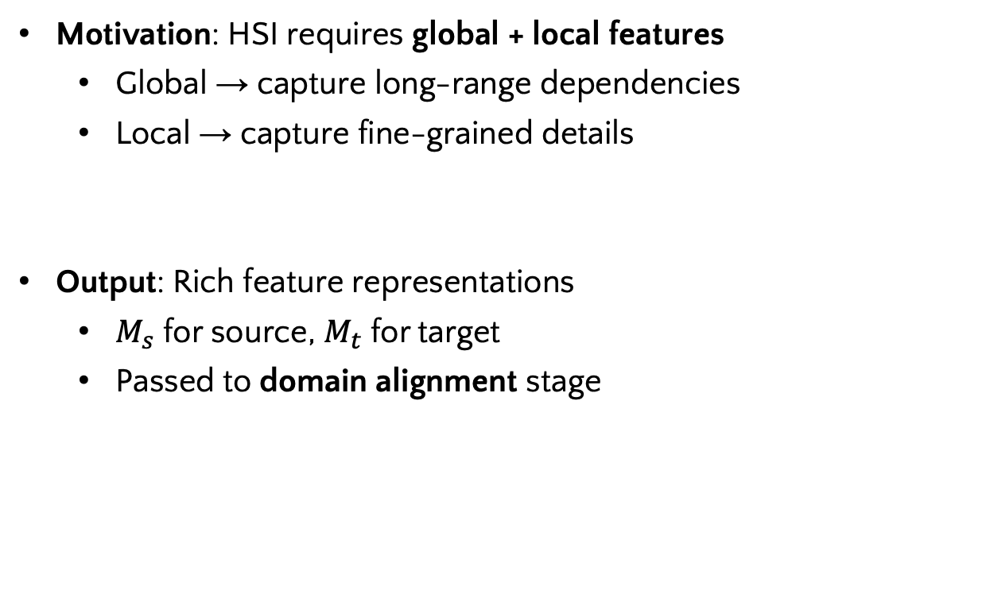
Method: A. Feature Extractor (GLMC)
Motivation: HSI requires global + local features
Global → capture long-range dependencies
Local → capture fine-grained details
Output: Rich feature representations
$M_{s}$ for source, $M_{t}$ for target
Passed to domain alignment stage

Slide 11
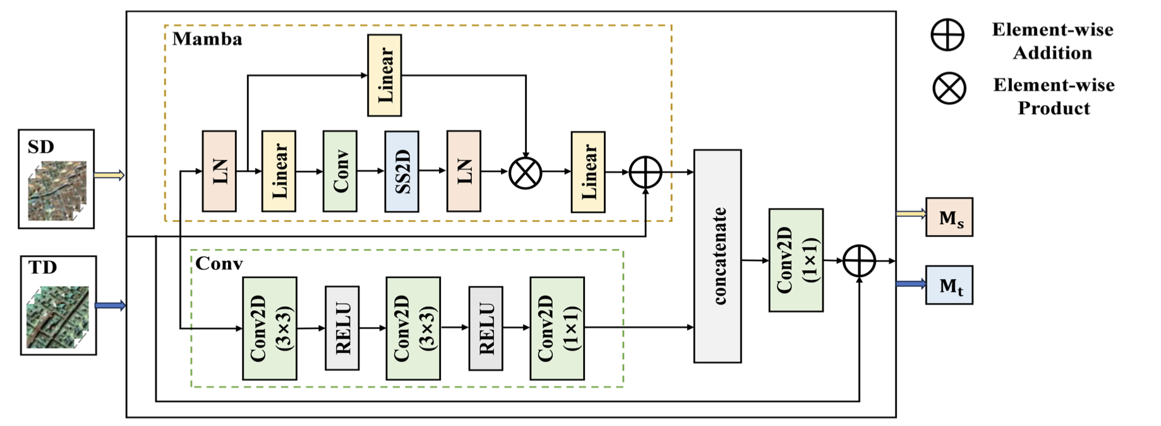
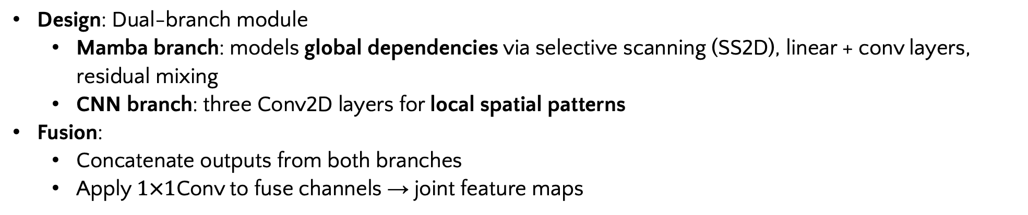
Method: A. Feature Extractor (GLMC)
Design: Dual-branch module
Mamba branch: models global dependencies via selective scanning (SS2D), linear + conv layers, residual mixing
CNN branch: three Conv2D layers for local spatial patterns
Fusion:
Concatenate outputs from both branches
Apply $1×1$Conv to fuse channels → joint feature maps

Slide 12
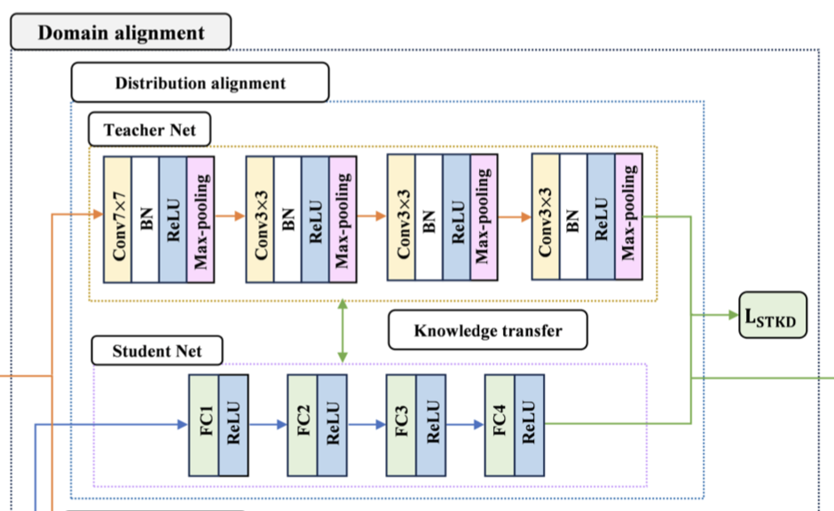
Method: B. Domain Alignment
1) Distribution Alignment (STKD)
Problem: Domain shift → SD and TD feature distributions differ.
Idea: Use knowledge distillation to transfer richer feature info from SD → TD.
Design:
Teacher network (trained on SD) produces soft labels → capture inter-class relationships.
Student network (on TD) learns to match teacher outputs via distillation loss.
Combine distillation loss + alignment loss for balanced training.
Effect: Enhances inter-class consistency, reduces domain gap.

Slide 13
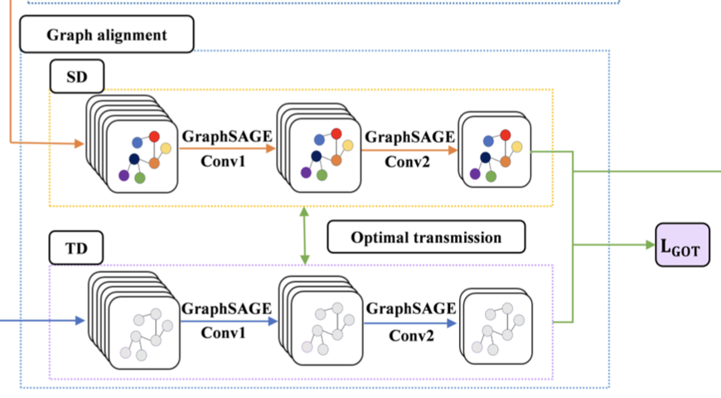
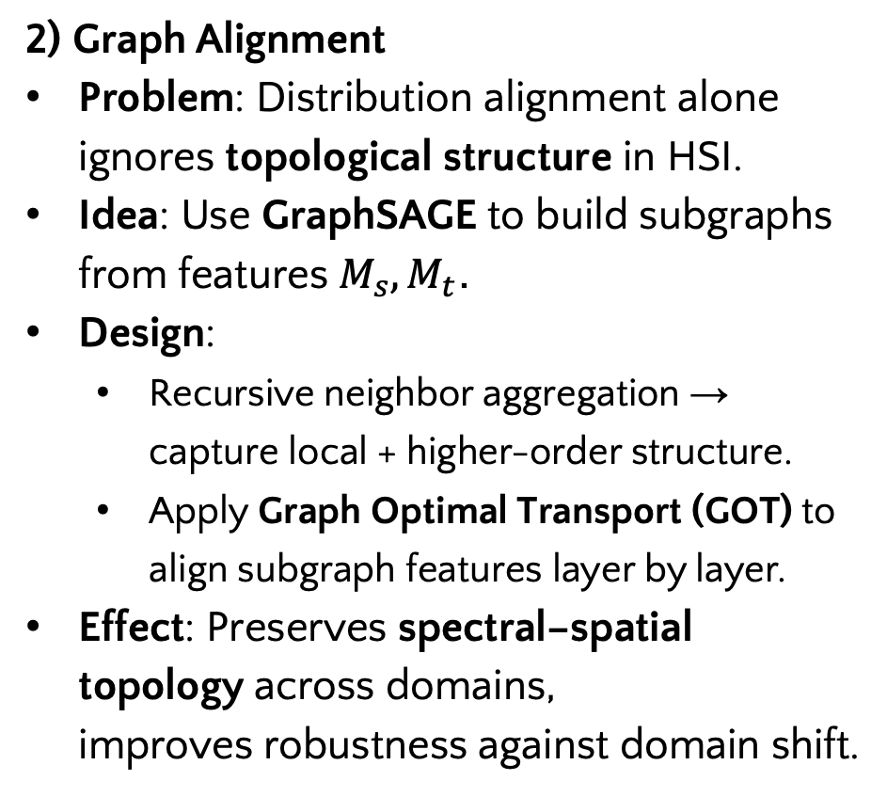
Method: B. Domain Alignment
2) Graph Alignment
Problem: Distribution alignment alone ignores topological structure in HSI.
Idea: Use GraphSAGE to build subgraphs from features $M_{s},M_{t}$.
Design:
Recursive neighbor aggregation → capture local + higher-order structure.
Apply Graph Optimal Transport (GOT) to align subgraph features layer by layer.
Effect: Preserves spectral–spatial topology across domains, improves robustness against domain shift.

Slide 14
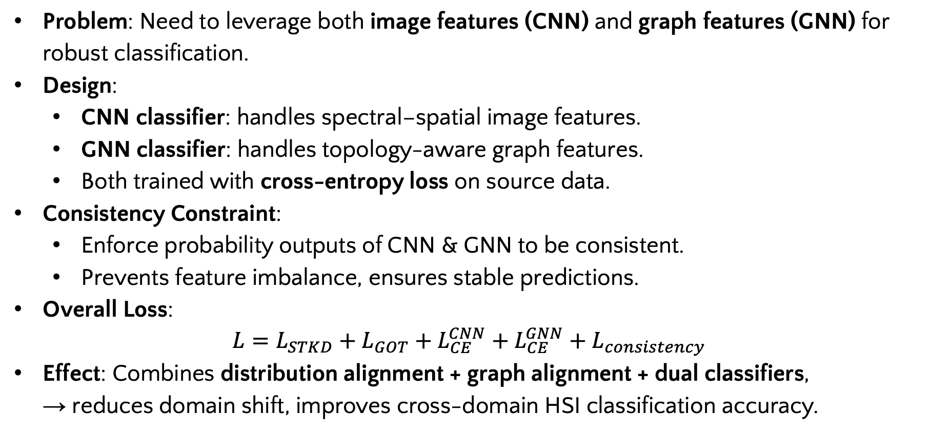
Method: C. Classifiers of MKDnet
Problem: Need to leverage both image features (CNN) and graph features (GNN) for robust classification.
Design:
CNN classifier: handles spectral–spatial image features.
GNN classifier: handles topology-aware graph features.
Both trained with cross-entropy loss on source data.
Consistency Constraint:
Enforce probability outputs of CNN & GNN to be consistent.
Prevents feature imbalance, ensures stable predictions.
Overall Loss:
$$L=L_{STKD}+L_{GOT}+L_{CE}^{CNN}+L_{CE}^{GNN}+L_{consistency}$$
Effect: Combines distribution alignment + graph alignment + dual classifiers, → reduces domain shift, improves cross-domain HSI classification accuracy.

Slide 15
Outline
Introduction
Method
Experiments
Conclusion

Slide 16
Experiments Datasets
Houston (2013 & 2018)
Different sensors, temporal gap → clear domain shift
7 common classes used for DA task
HyRANK (Dioni & Loukia)
Hyperion sensor, 176 bands
12 common classes → vegetation prone to misclassification
Pavia (University & Center)
Acquired by ROSIS sensor, Italy
7 consistent classes → urban variation, same city but different scenes

Slide 17
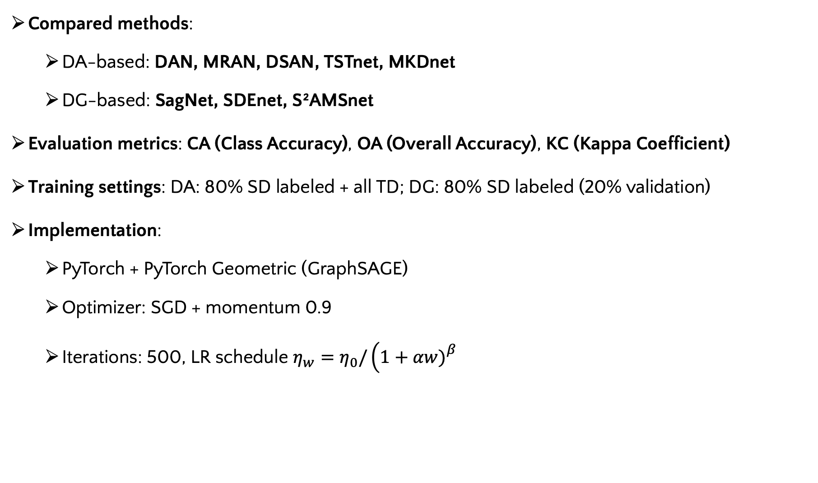
Experiments Setup
Compared methods:
DA-based: DAN, MRAN, DSAN, TSTnet, MKDnet
DG-based: SagNet, SDEnet, S²AMSnet
Evaluation metrics: CA (Class Accuracy), OA (Overall Accuracy), KC (Kappa Coefficient)
Training settings: DA: 80% SD labeled + all TD; DG: 80% SD labeled (20% validation)
Implementation:
PyTorch + PyTorch Geometric (GraphSAGE)
Optimizer: SGD + momentum 0.9
Iterations: 500, LR schedule $η_{w}=η_{0}/\left(1+αw{\left.)\right.}^{β}\right.$

Slide 18
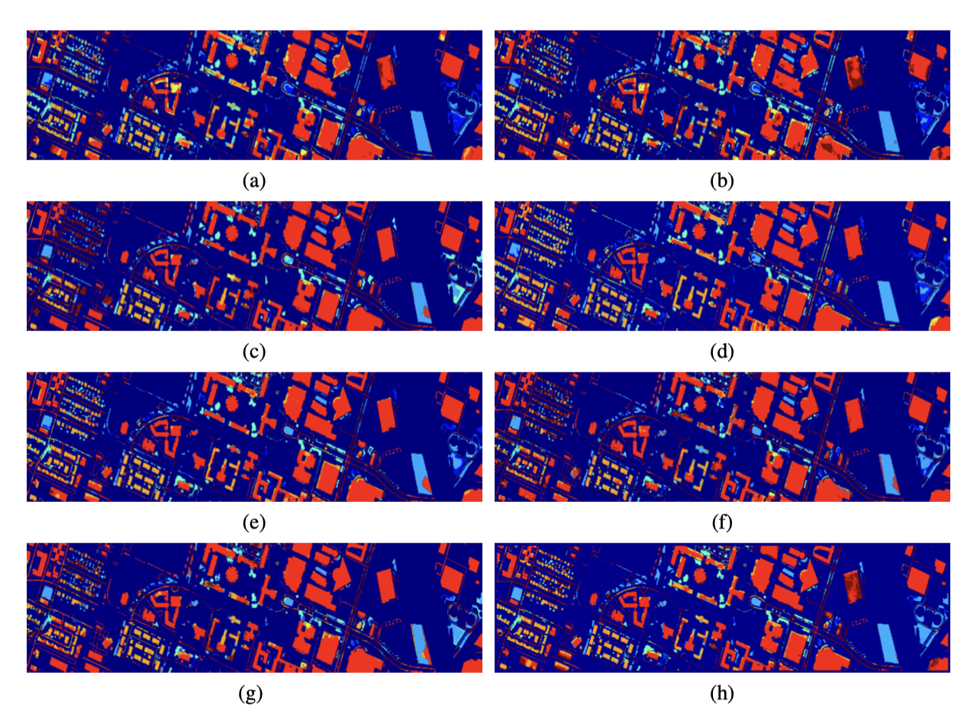
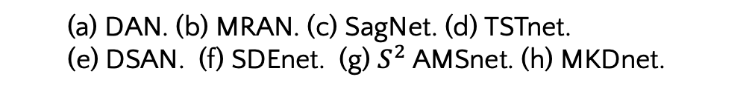
Experiments Results: Houston.
Visual results of Houston
MKDnet produces cleaner, more accurate classification maps across Houston.
Outperforms 7 advanced DA/DG methods.
(a) DAN. (b) MRAN. (c) SagNet. (d) TSTnet.
(e) DSAN. (f) SDEnet. (g) $S^{2}$ AMSnet. (h) MKDnet.

Slide 19
Experiments Results: Houston.
Table; Classification Results on Pavia Center Dataset
Class | DAN | SagNet | MRAN | TSTNet | DSAN | SDEnet | S²AMSNet | MKDnet
1 | 50.85 | 24.79 | 54.39 | 82.03 | 57.95 | 25.49 | 35.79 | 38.59
2 | 72.38 | 62.19 | 75.77 | 68.73 | 67.90 | 83.26 | 59.99 | 85.29
3 | 61.77 | 48.66 | 68.79 | 52.82 | 71.69 | 58.31 | 77.64 | 69.08
4 | 100 | 81.02 | 64.33 | 100 | 81.82 | 100 | 100 | 76.36
5 | 67.43 | 59.57 | 68.50 | 61.71 | 61.79 | 62.34 | 45.95 | 75.58
6 | 73.11 | 88.29 | 70.54 | 84.44 | 70.26 | 85.36 | 90.12 | 77.92
7 | 63.99 | 33.99 | 54.21 | 53.07 | 54.53 | 55.16 | 64.48 | 54.10
OA(%) | 67.77 | 73.11 | 68.99 | 75.34 | 67.08 | 75.99 | 75.73 | 76.11
KC(x100) | 51.17 | 55.39 | 52.67 | 59.69 | 52.05 | 60.77 | 60.54 | 60.87
MKDnet surpasses baselines by 1%–9% OA on key target scenes on Houston.

Slide 20
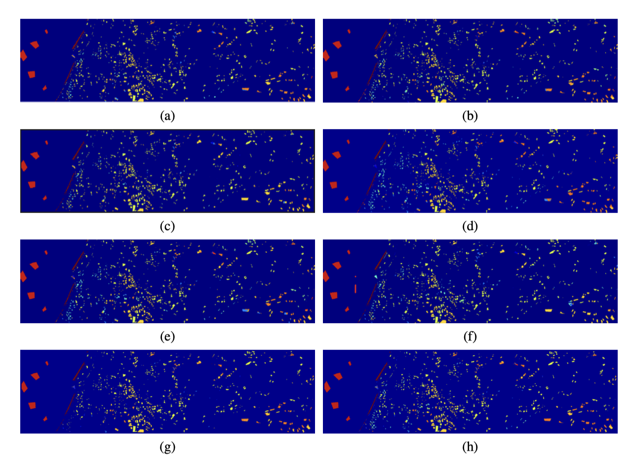
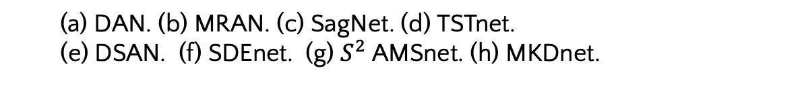
Experiments Results: HyRANK.
Visual results of Houston
MKDnet produces cleaner, more accurate classification maps across HyRANK.
(Outperforms 7 advanced DA/DG methods.
(a) DAN. (b) MRAN. (c) SagNet. (d) TSTnet.
(e) DSAN. (f) SDEnet. (g) $S^{2}$ AMSnet. (h) MKDnet.

Slide 21
Experiments Results: HyRANK.
Table; Classification Results on Loukia Center Dataset
Class | DAN | SagNet | MRAN | TSTNet | DSAN | SDEnet | S²AMSNet | MKDnet
1 | 11.66 | 21.99 | 12.78 | 39.81 | 26.21 | 35.32 | 39.39 | 37.72
2 | 43.44 | 7.14 | 0 | 24.07 | 18.52 | 13.63 | 0 | 46.11
3 | 22.07 | 49.70 | 5.11 | 14.79 | 23.71 | 60.44 | 51.34 | 23.47
4 | 11.77 | 16.46 | 0 | 1.27 | 0 | 8.78 | 0 | 25.70
5 | 3.22 | 0.22 | 28.43 | 28.01 | 48.69 | 2.63 | 0 | 1.30
6 | 20.71 | 34.65 | 40.51 | 5.45 | 45.97 | 23.36 | 26.69 | 25.40
7 | 71.66 | 80.77 | 64.23 | 64.57 | 60.58 | 72.98 | 55.26 | 73.47
8 | 63.22 | 62.71 | 70.99 | 62.60 | 67.26 | 70.63 | 53.82 | 64.34
9 | 53.11 | 59.46 | 7.02 | 73.68 | 37.09 | 19.80 | 12.23 | 37.09
10 | 0 | 1.10 | 0.22 | 2.21 | 4.86 | 18.77 | 0 | 4.21
11 | 99.79 | 100 | 100 | 100 | 100 | 100 | 100 | 100
12 | 100 | 100 | 100 | 100 | 100 | 100 | 90.93 | 100
OA(%) | 56.43 | 61.77 | 58.65 | 62.66 | 60.92 | 61.37 | 55.75 | 63.01
KC(x100) | 44.69 | 52.12 | 49.32 | 54.20 | 52.44 | 52.99 | 45.78 | 54.98

Slide 22
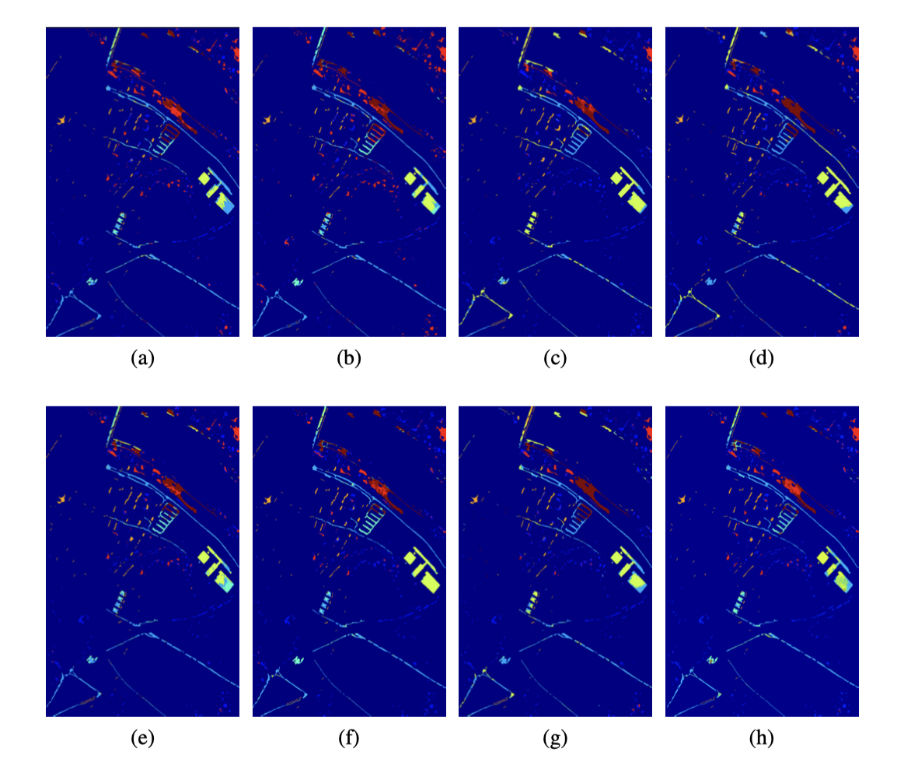
Experiments Results: Pavia
Visual results of Houston
MKDnet produces cleaner, more accurate classification maps across Pavia.
(Outperforms 7 advanced DA/DG methods.
(a) DAN. (b) MRAN. (c) SagNet. (d) TSTnet.
(e) DSAN. (f) SDEnet. (g) $S^{2}$ AMSnet. (h) MKDnet.

Slide 23
Experiments Results: Pavia
Table; Classification Results on Pavia Center Dataset
Class | DAN | SagNet | MRAN | TSTNet | DSAN | SDEnet | S²AMSNet | MKDnet
1 | 73.79 | 96.34 | 60.16 | 51.82 | 84.39 | 86.32 | 89.42 | 78.48
2 | 78.65 | 56.87 | 78.77 | 79.76 | 76.34 | 80.32 | 77.12 | 81.96
3 | 80.77 | 6.31 | 54.75 | 60.41 | 54.77 | 69.53 | 25.36 | 51.10
4 | 66.43 | 79.66 | 67.32 | 31.44 | 74.65 | 70.31 | 70.98 | 35.06
5 | 96.23 | 90.40 | 68.63 | 74.64 | 98.66 | 76.32 | 92.36 | 86.18
6 | 73.46 | 50.33 | 86.45 | 86.99 | 74.98 | 75.91 | 42.18 | 77.62
7 | 70.13 | 57.99 | 62.31 | 51.09 | 67.36 | 60.34 | 67.62 | 60.14
OA(%) | 73.99 | 69.71 | 68.87 | 69.63 | 72.96 | 74.36 | 72.87 | 74.94
KC(x100) | 68.89 | 63.14 | 62.36 | 64.08 | 68.32 | 69.12 | 67.65 | 69.73
MKDnet surpasses baselines by 1%–9% OA on key target scenes on Pavia Center.

Slide 24
Outline
Introduction
Method
Experiments
Conclusion
Notes:
“Alright, that’s it for the experiments. Next, I’ll wrap up with the Conclusion.”

Slide 25
Conclusion
1. Understanding the Gap
Cross-domain HSI classification suffers from domain shift (sensor, time, environment).
Existing DA/DG methods are limited:
Focus only on marginal distribution → ignore inter-class consistency.
Biased toward local (CNN) or global (Transformer, SSM) features → lack comprehensive extraction.
Gap: Need joint global+local features + robust domain alignment.
2. Our Method (MKDnet)
Hybrid extractor (Mamba + CNN) → captures long-range dependencies + fine local details.
STKD distillation → preserves inter-class feature consistency with soft labels.
Graph alignment (GCN + GOT) → models spectral–spatial topology, enhances alignment robustness.
Unified loss combines feature extraction + distribution alignment + graph alignment.
3. Experimental Results: MKDnet effectively addresses feature extraction + domain alignment, providing robust cross-domain HSI classification.

Slide 26

Motivation:
Domain shift: sensor variability, weather, seasonal change → spectral differences
Existing DA methods:
Distribution alignment
Feature selection
Subspace learning → fail with large SD–TD discrepancy
Feature extraction limits:
CNN → local only
Transformer → global, but costly, miss details
Mamba → efficient long-range, weak local
Gap: need local + global feature extraction + robust domain alignment

Slide 27
Main Contribution:
Hybrid Network (MKDnet):
Mamba + CNN → joint global & local feature extraction, capturing long-range dependencies and fine details.
Knowledge Distillation (STKD):
Soft-label distillation → strengthen inter-class feature consistency during alignment.
Graph Alignment:
GCN-based subgraph updates + consistency constraints on distribution & graph alignment → robust against domain shift.
Overall: Improved cross-domain HSI classification accuracy by addressing both feature extraction and domain alignment challenges.

